Slide 1

Signal Analysis

Slide 2
Outline
Pixelwise vs ROI
Signal decay model
Rician noise
Fitting approaches
Appropriate calibration curves
Available software tools
Freeware demonstration

Slide 3
Pixelwise vs ROI based
X
X
X
X
X
R2* (Hz)
For homogeneous iron distribution, ROI based methods are more accurate.
With non-homogeneous iron distributions, ROI based methods will underestimate true iron.
Even if using an ROI based method, quick pixelwise mapping can help delineate boundaries.

Slide 4
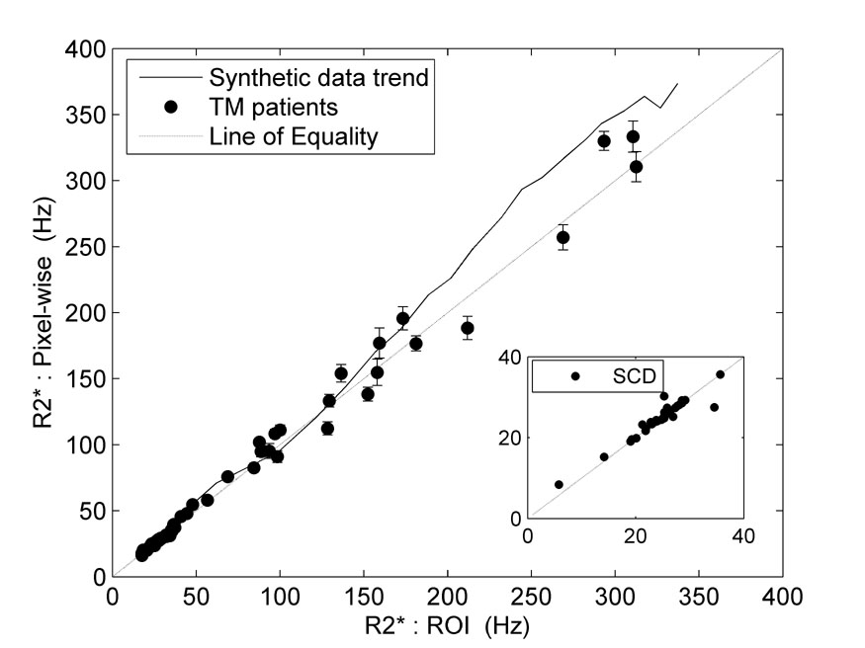
ROI versus Pixelwise in Heart
Ghugre et al, JMRI, 2006

Slide 5

Signal decay
SI =ρ(1-exp^{(-TR/T1)}) sinθexp^{(-TE/T2*)} /(1-cosθ exp^{(-TR/T1)})
Since only TE is changing between echoes this ->
SI = A exp ^{(TE/T2*)} (2 components)
In the presence of significant partial volume effects
SI = A₁ exp ^{(TE/T2*}1⁾ ⁺ A₂ exp ^{(TE/T2*}2⁾ (4 components)
If T2*₂ is >> TE_{max}
SI = A₁ exp ^{(TE/T2*}1⁾ ⁺ A₂ (3 components)
T2* of blood, bile >> liver

Slide 6
Rician Noise
All MRI images have noise that becomes important for late echoes
MRI noise is “Rician” which means that it is non-zero

Slide 7
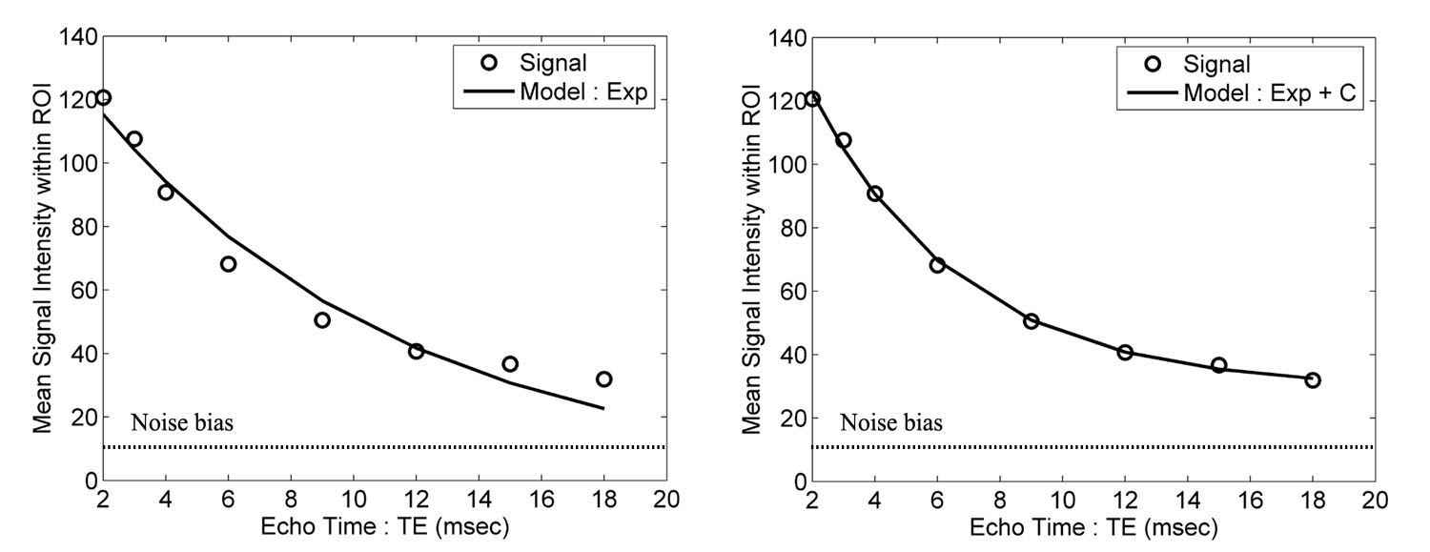
Correct Fitting
Heart and liver contain both high iron and low iron containing tissues.
Signal decay curves have a dominant “Fast” and a small “Slow” component.
Four ways to compensate:
Truncate the fit after a few points (2 DOF).
Fit both the “Fast” and “Slow” components (4 DOF).
Assume the slow component is roughly “Constant” (3 DOF).
Fit in the complex plane (or filter in the complex plane).

Slide 8
Use of truncation
Simple
Most commercial software use this approach
Only valid when partial volume effects are small
Keep your ROI’s peripheral in the liver
Truncation point is subjective
Vulnerable to fat-water interactions

Slide 9
Existing Software Tools
Medis, https://www.medis.nl/apps/t2t2star
CMR Tools, http://www.cmrtools.com/cmrweb/ThalassaemiaToolsIntroduction.htm
Circle 42, https://www.circlecvi.com/features/T2Star-map.php
GE Starmap, http://www3.gehealthcare.co.uk/~/media/documents/us-global/products/advanced-visualization/product%20spec%20sheets/starmap-40/gehc-datasheet_aw-starmap-40.pdf?Parent=%7B9A72788E-F4D0-46C4-9E37-9BDDC05F280F%7D
Siemens Myomaps, https://www.healthcare.siemens.com/magnetic-resonance-imaging/options-and-upgrades/clinical-applications/myomaps

Slide 10
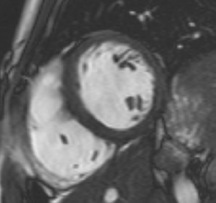
Where to draw heart ROI
Full thickness boundaries (like doing LV function)
Septum only
Pull back from RV hinge points by ~ 5 mm
Can examine late echoes for susceptibility artifact.
Porta-caths and excessive respiratory motion can lower T2*

Slide 11
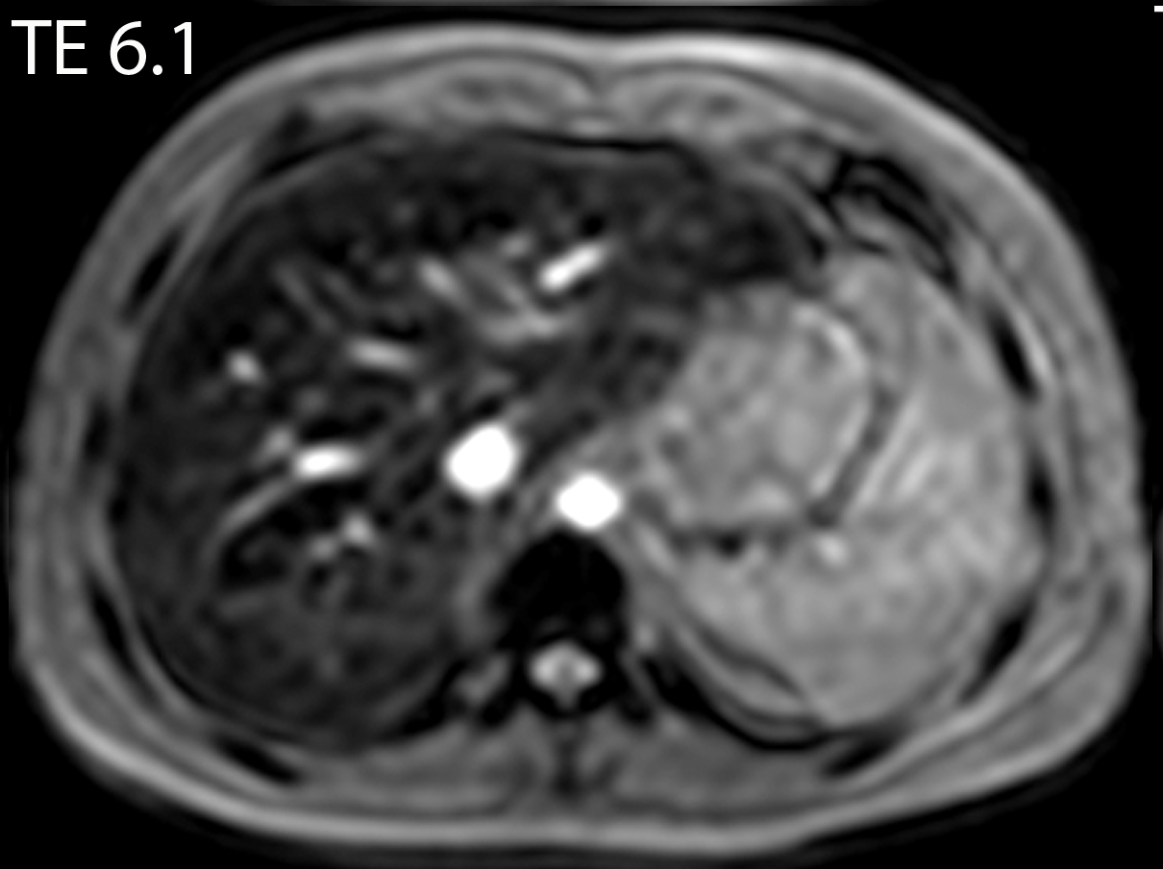
Where to draw liver ROI
For ROI with Truncation
Find echo time with contrast
Trace outer 1-2 cm
For Mapping
Trace whole liver contour
Avoid aorta and major hilar vessels

Slide 12
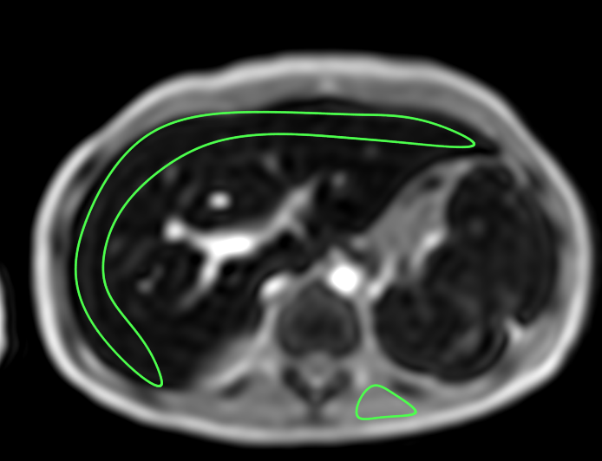
Demonstration
http://www.isodense.com/ic
TE | Signal
1 | 411
1.7 | 378
2.4 | 351
3.1 | 335
3.8 | 317
4.5 | 299
5.2 | 279
5.9 | 261
6.6 | 244
7.3 | 229
8.0 | 215
8.7 | 202
TE | Signal
1 | 298
1.7 | 202
2.4 | 147
3.1 | 104
3.8 | 76.8
4.5 | 54.4
5.2 | 40.2
5.9 | 27.4
6.6 | 20.9
7.3 | 15.5
8.0 | 14.4
8.7 | 13.0
TE | Signal
1 | 87.8
1.7 | 24.6
2.4 | 12.9
3.1 | 11.2
3.8 | 12.7
4.5 | 12.0
5.2 | 9.5
5.9 | 11.6
6.6 | 10.0
7.3 | 8.4
8.0 | 8.7
8.7 | 8.3
SI = 87.8
SI = 340
T2* = 11.0 ms
T2* = 2.1 ms
T2* < 0.6 ms

Slide 13
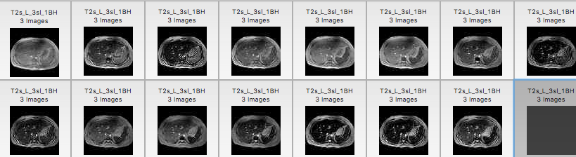
Effects of fat
TE | Signal
1 | 432
1.7 | 380
2.4 | 357
3.1 | 366
3.8 | 368
4.5 | 323
5.2 | 351
5.9 | 312
6.6 | 308
7.3 | 305
8.0 | 292
8.7 | 279
TE | Signal
1 | 218
1.7 | 105
2.4 | 59.4
3.1 | 148
3.8 | 188
4.5 | 169
5.2 | 100
5.9 | 35.2
6.6 | 76.2
7.3 | 114
8.0 | 109
8.7 | 75.2
T2* = 20.9 ms
T2* = 12.8 ms

Slide 14
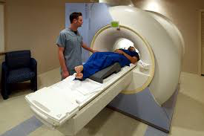
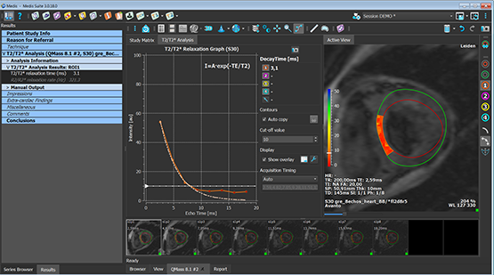
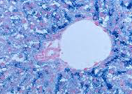
How do we get an iron value ?
Acquisition
Analysis
Calibration Curves
T2* or R2*
LIC Value

Slide 15
Use the right calibration curve
Meloni et al, BJH, 2014

Slide 16
Calculation from 1.5 T data
File is called “1.5T Calibration”

Slide 17
Review for Truncation
ROI
Peripheral in liver (1-2 cm thick)
Full thickness septal in heart
Truncate
Optimize fit for the early echoes
Remember the effects of fat
Sanity Check
If the tissue is dark in the first image, beware !
Use the correct equation
The Garbowski equation is correct for truncated model

Slide 18

Questions?

